Slide 1



Sequential Ensemble Learning for Outlier Detection:
A Bias-Variance Perspective
Shebuti Rayana
Wen Zhong
Leman Akoglu
ICDM 2016
Barcelona, Spain

Slide 2
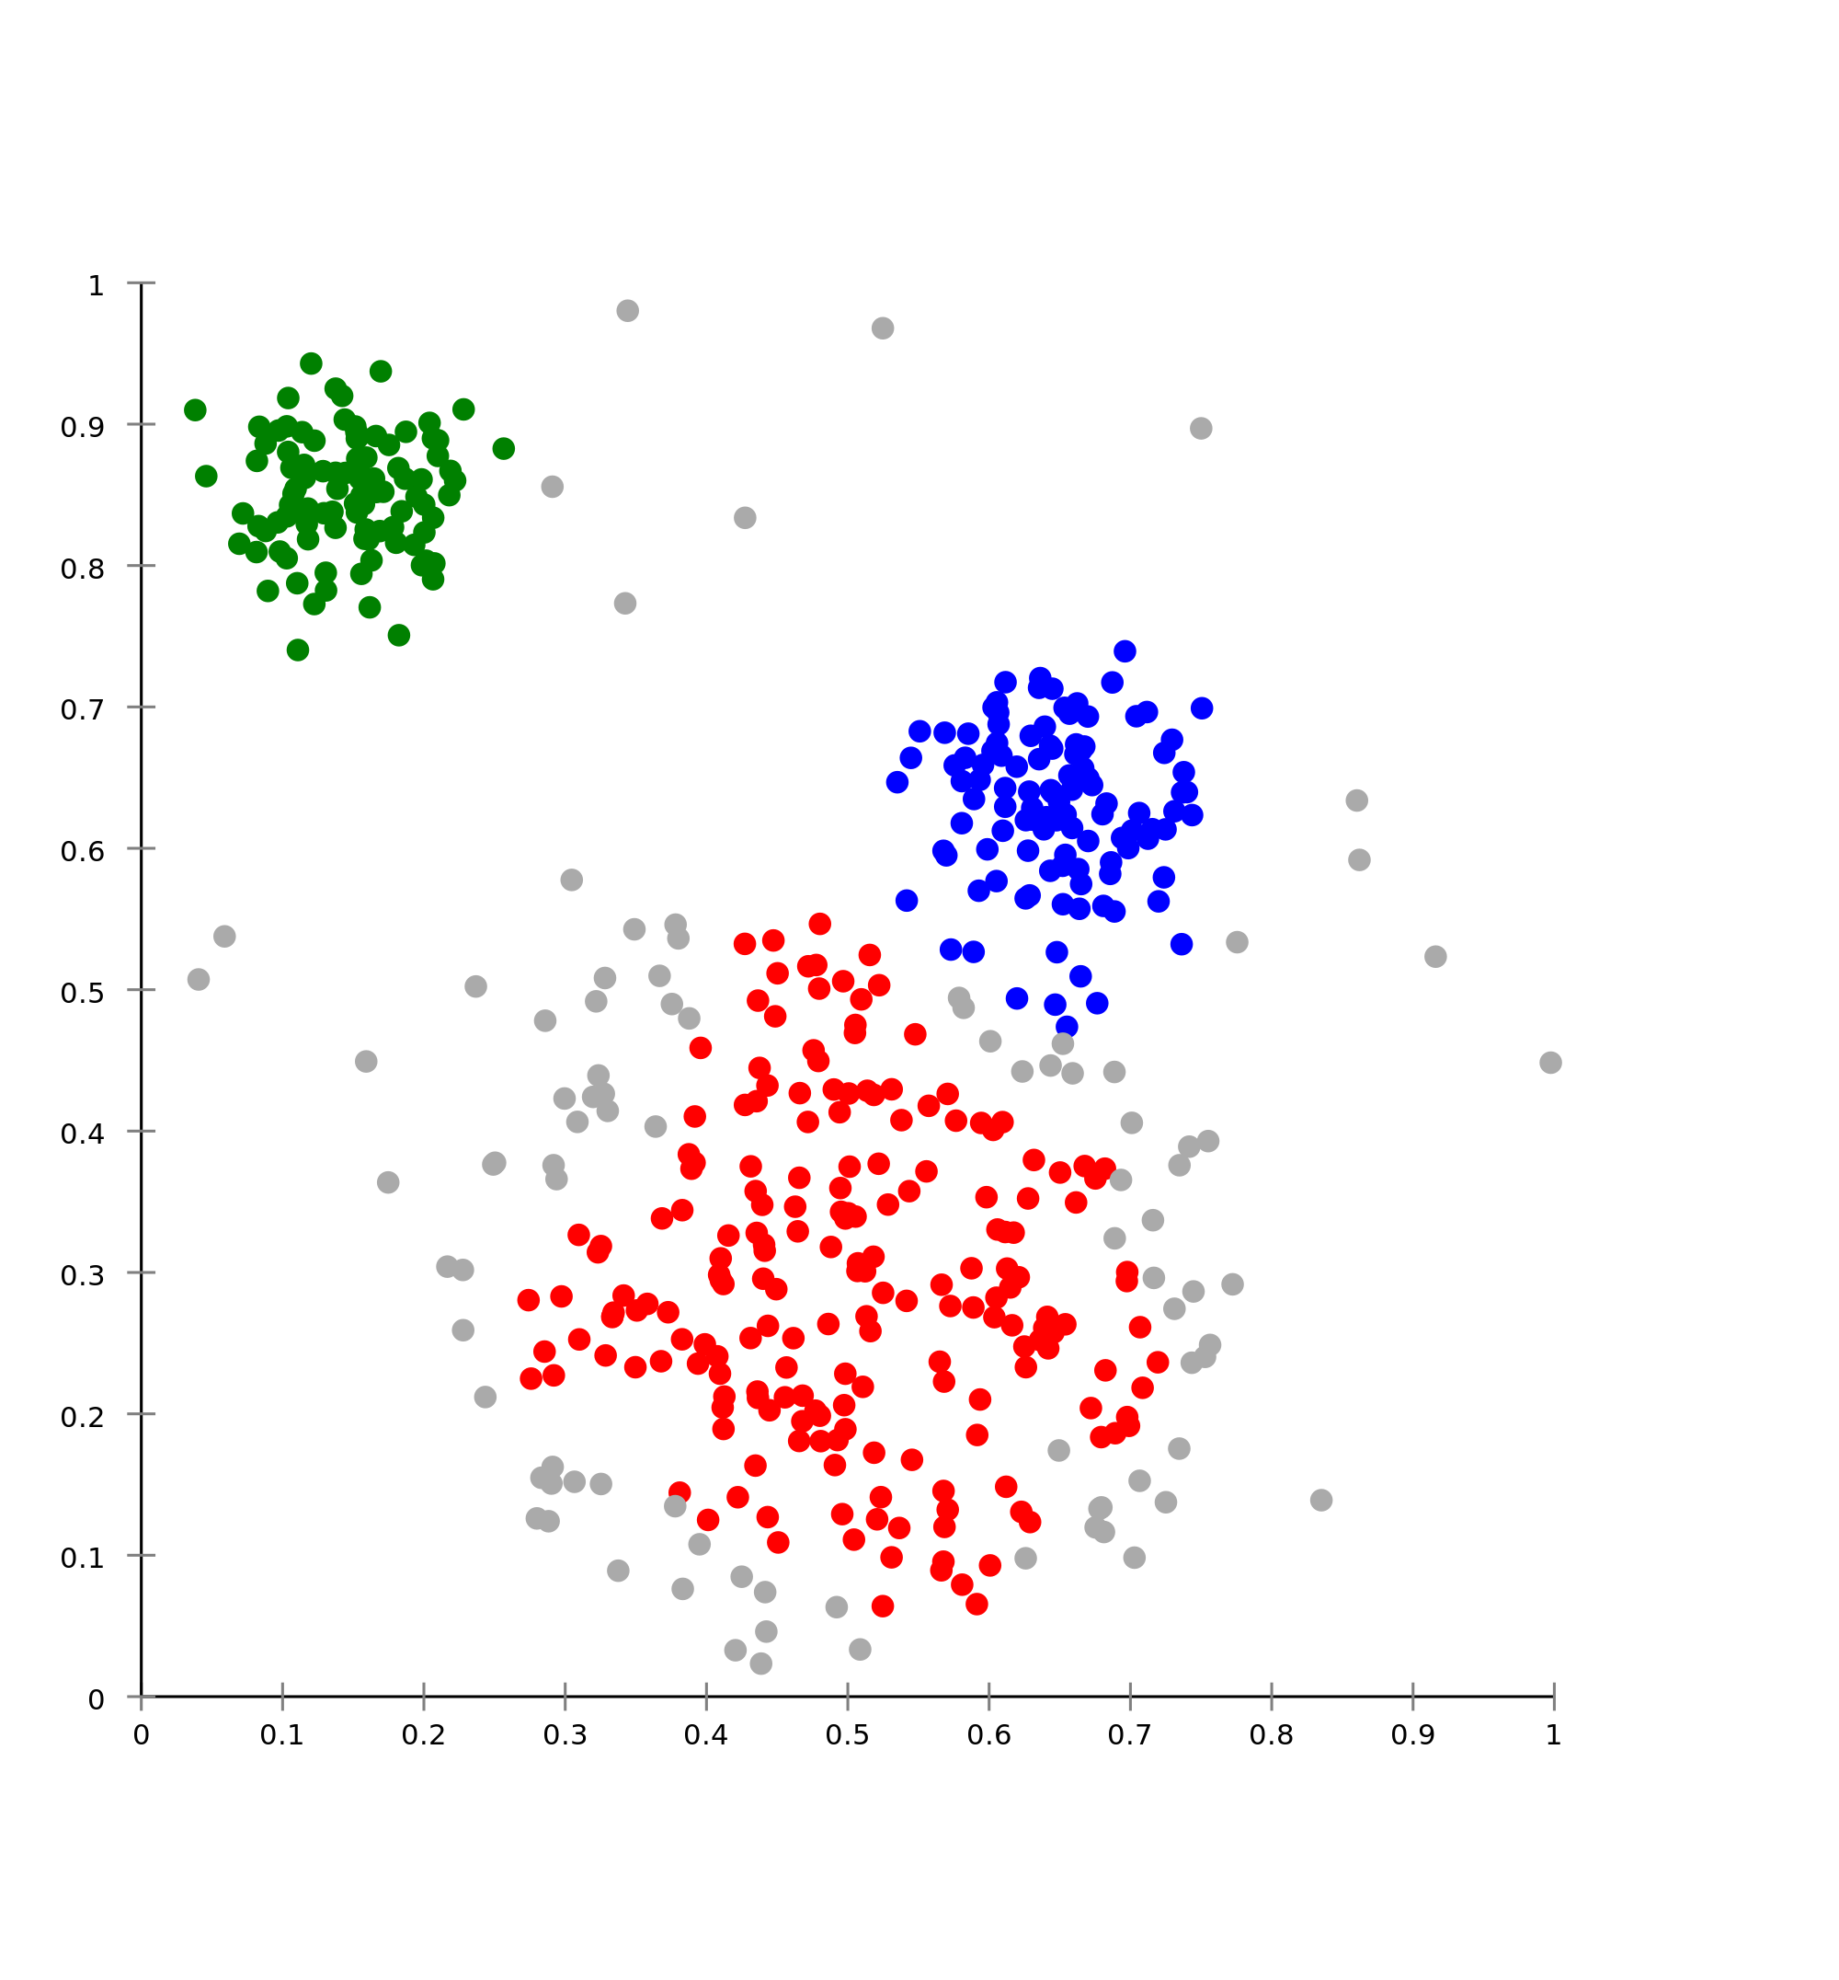
Outlier Detection
… in point data
Many approaches
  density-based,
  distance-based,
  depth-based,
  angle-based,
  …
Can we leverage “strength of the many”?
  How to learn outlier ensembles?

Slide 3
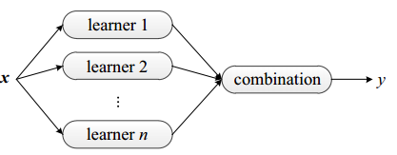
Ensemble Learning
Bootstrap Aggregating [Breiman,1996]
Adaptive Boosting [Freund & Schapire,1997]
Random Forests [Breiman, 2001]

Slide 4
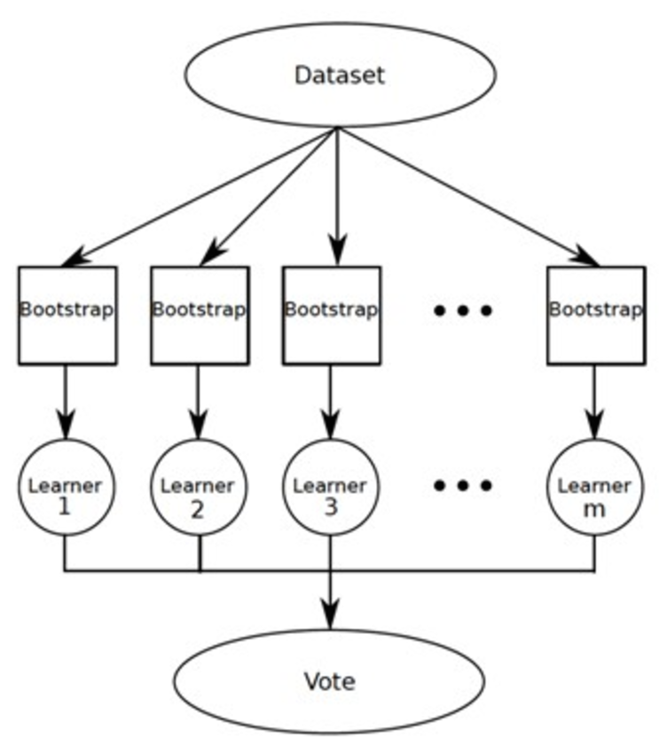
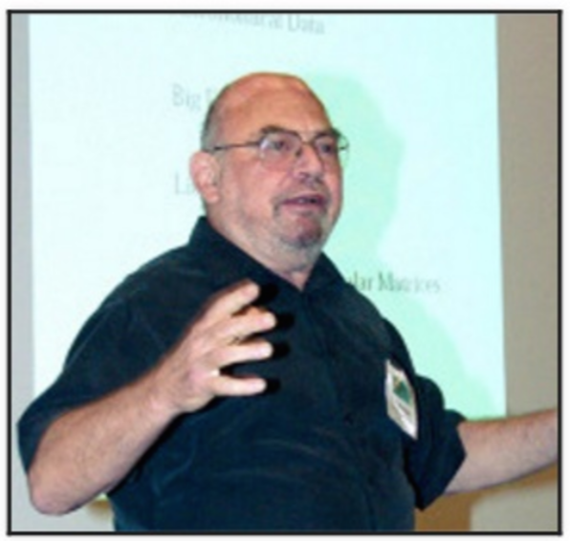
Ensemble Learning
Bootstrap Aggregating [Breiman,1996]

Slide 5
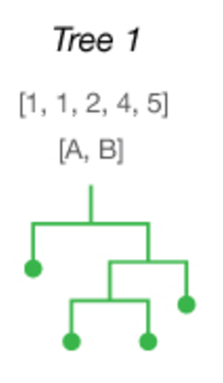
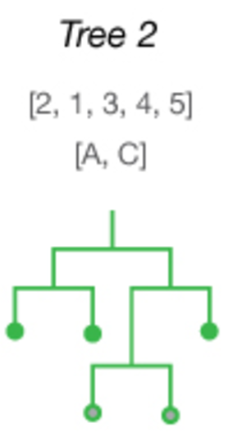
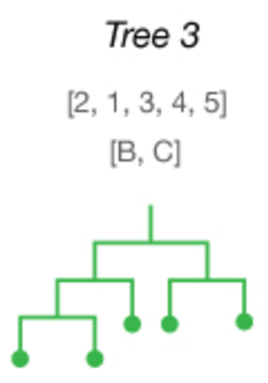
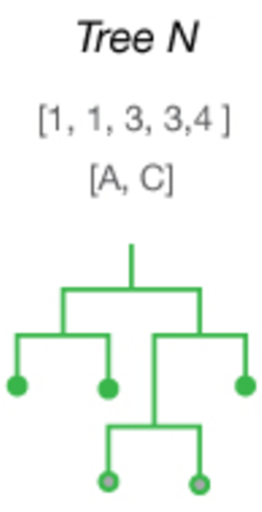

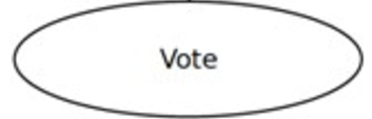
Ensemble Learning
Random Forests [Breiman, 2001]

Slide 6
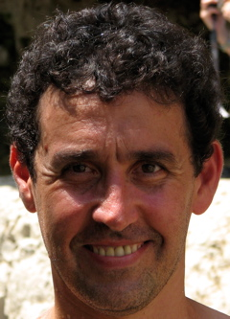
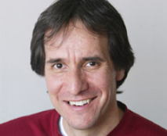
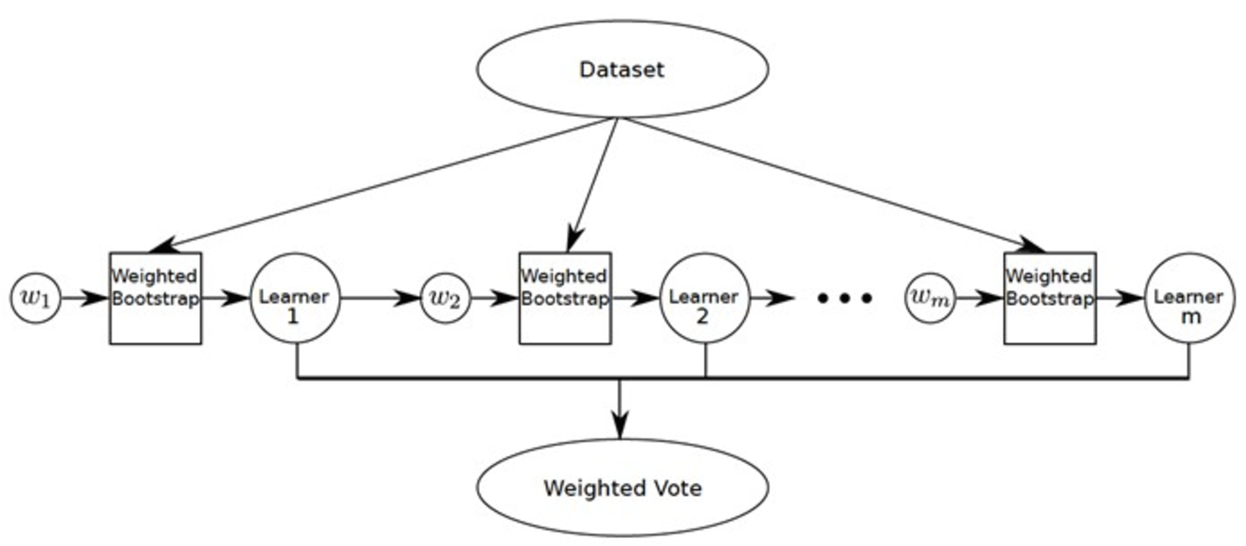
Ensemble Learning
Adaptive Boosting [Freund & Schapire,1997]

Slide 7
Outlier Ensembles
What detectors? How to assemble?
Parallel? Sequential?

Slide 8
Outlier Ensembles
What detectors? How to assemble?
  Feature Bagging [Lazarevic & Kumar, 2005]
    avg, max
  Isolation Forest [Liu,Ting,Zhou; 2008]
  ULARA [Klementiev, Roth, Small; 2007]
    weighted voting
Parallel? Sequential?

Slide 9


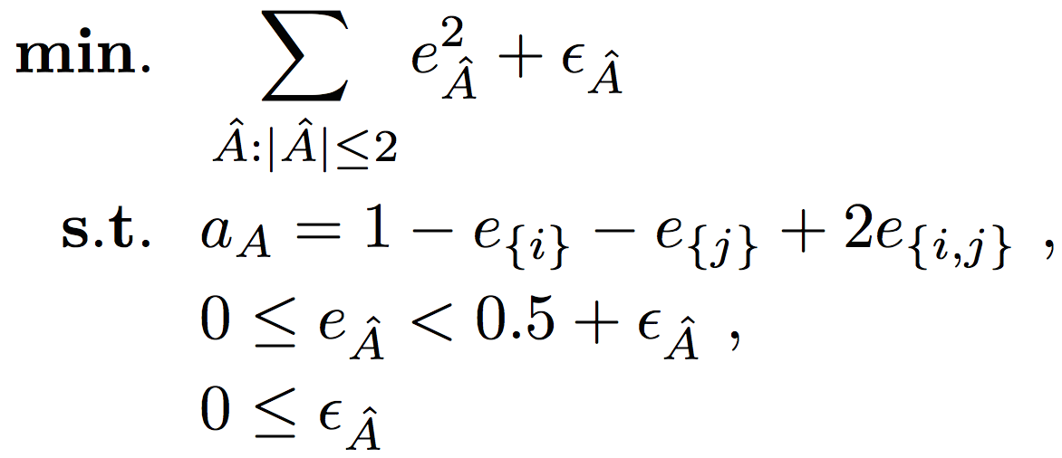
agreement rates –to–> error rates
[Platanios, Blum, Mitchell; 2014]
pairwise
agreement
rates
(computed
from
outputs)
error rates
(unknown)
Notes:
The set of 2 N −N −1 equations involving 2 N −1 unknown variables yields an underdetermined system of equations with an infinite number of possible solutions. We therefore cast this problem as a constrained optimization problem where the agreement equations form constraints that must be satisfied

Slide 10
Outlier Ensembles
What detectors? How to assemble?
Parallel? Sequential?
BOTH!

Slide 11
Bias-Variance decomposition of Error
[Aggarwal & Sathe, 2015]
expected
error
Bias²
Variance
Notes:
Most ensembles reduce variance
Random forest:
learn low-bias/high-variance individual trees
average across trees to reduce variance

Slide 12
How to Reduce Bias?
Most outlier detectors are instance-based (i.e., use nearest neighbors):
  distance, density, isolation trees
Main idea: filter outliers to obtain true nearest neighbors
Notes:
Bias is low when the estimated model is close to the true model
Most outlier detectors are instance-based
If we can identify the “true dataset” on which to compute nearest neighbors

Slide 13
How to Reduce Bias?
Main idea: filter outliers to obtain true nearest neighbors […to detect outliers]
“chicken-egg problem”?!
filter obvious outliers (iteratively) to obtain approximately true nearest neighbors
CARE: Cumulative Agreement
Rates Ensemble

Slide 14
CARE: Main steps
1
S₁
S₂
S₃
S_{m}
2
Run m parallel
outlier detectors
Estimate detector
error-rates
…
score lists
detector weights
resampled data
Aggregate scores & weigh
dataset
Resample
dataset
4
re-weighted data
3

Slide 15
CARE: Main steps
Parallel aggregation
1
2
3
Run m parallel
outlier detectors
Estimate detector
error-rates
Aggregate scores & weigh
dataset
Sequential
aggregation
4
Resample
dataset

Slide 16
Bias-Variance reduction (simul.)
:

Slide 17
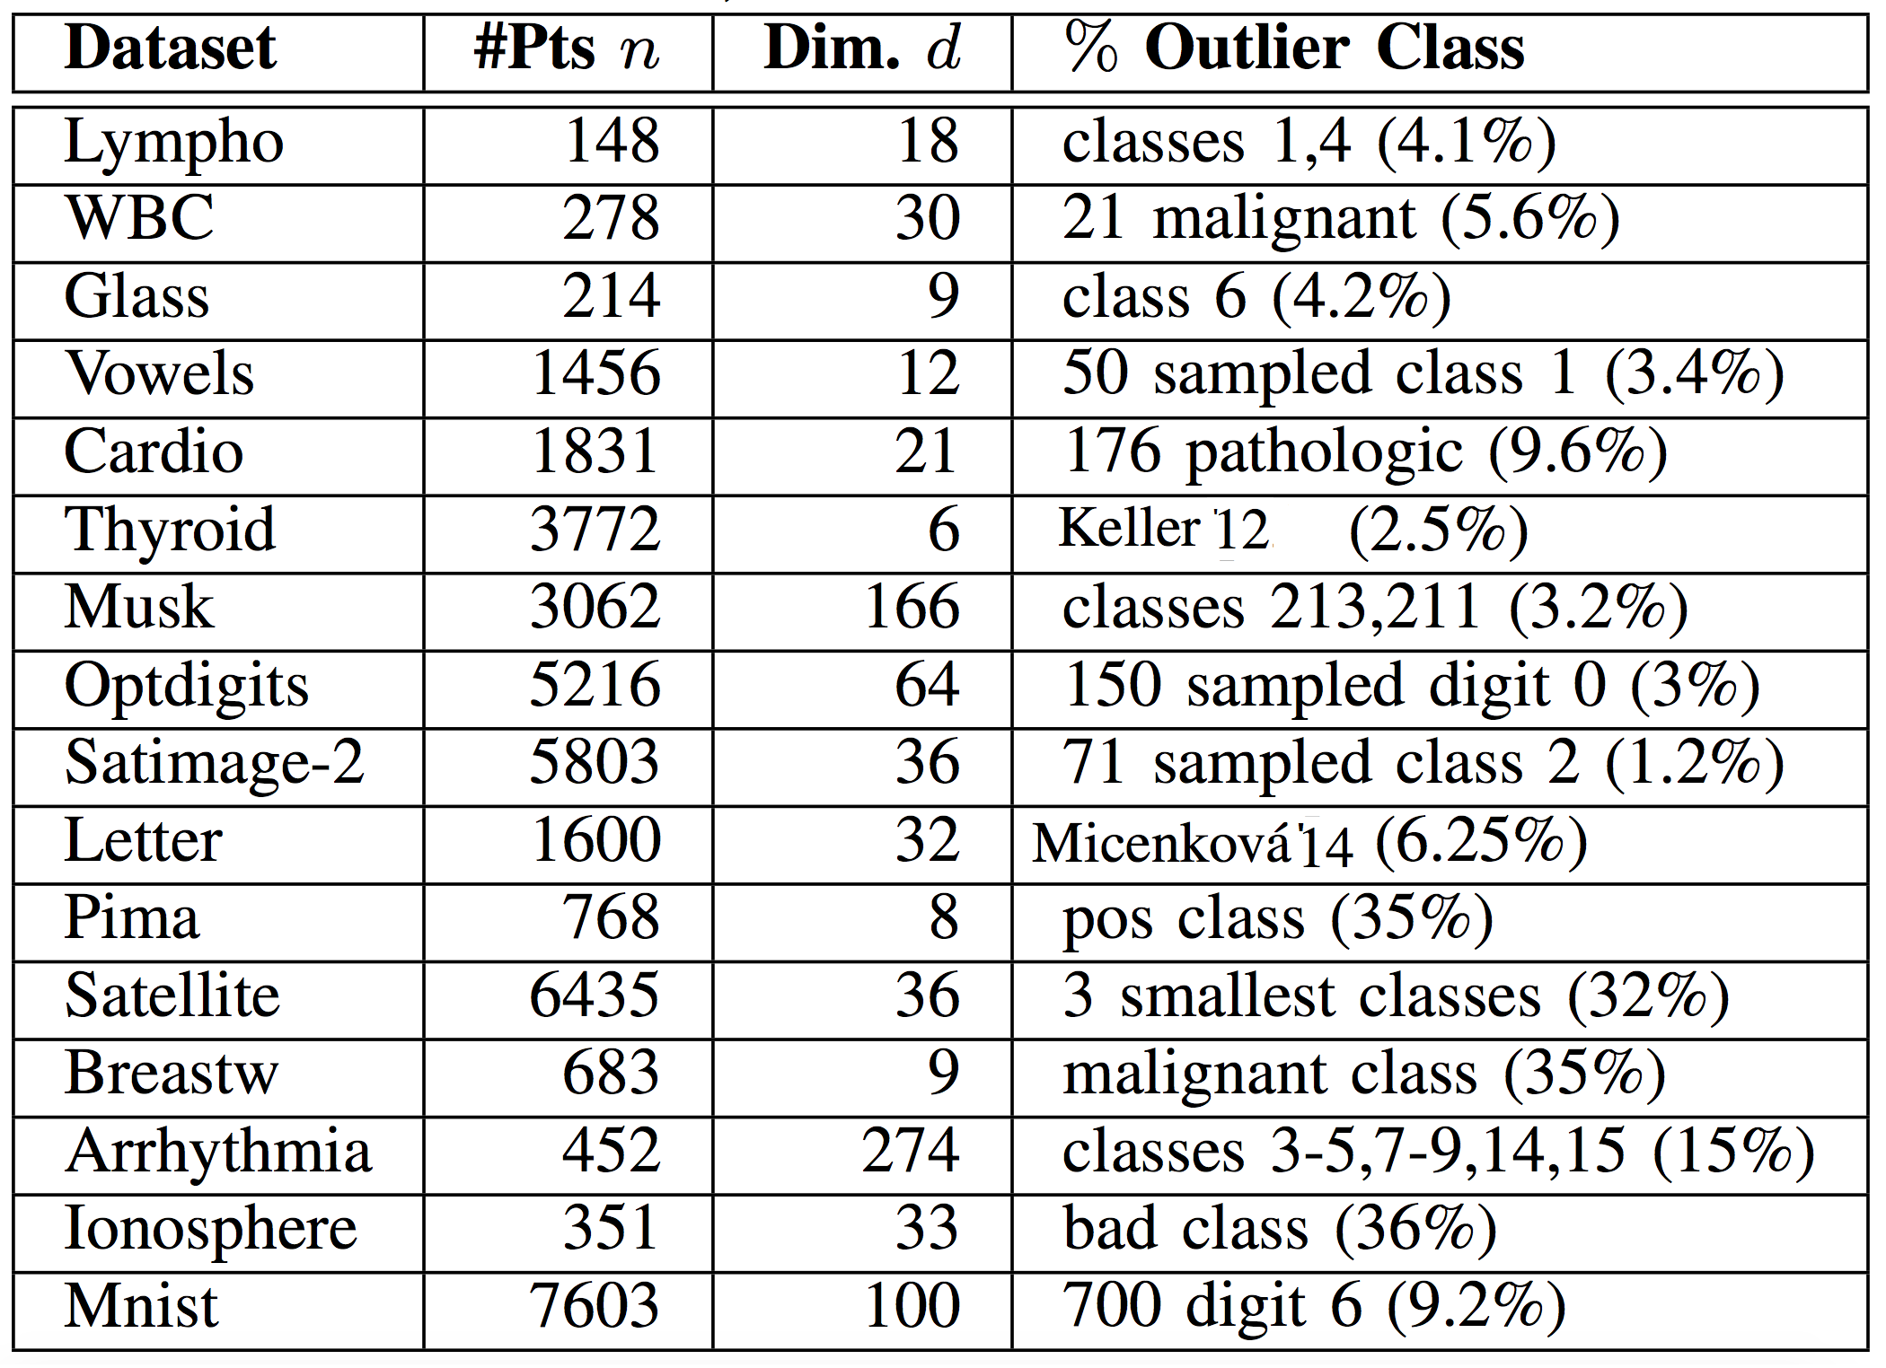
Experimented datasets
http://odds.cs.stonybrook.edu/

Slide 18
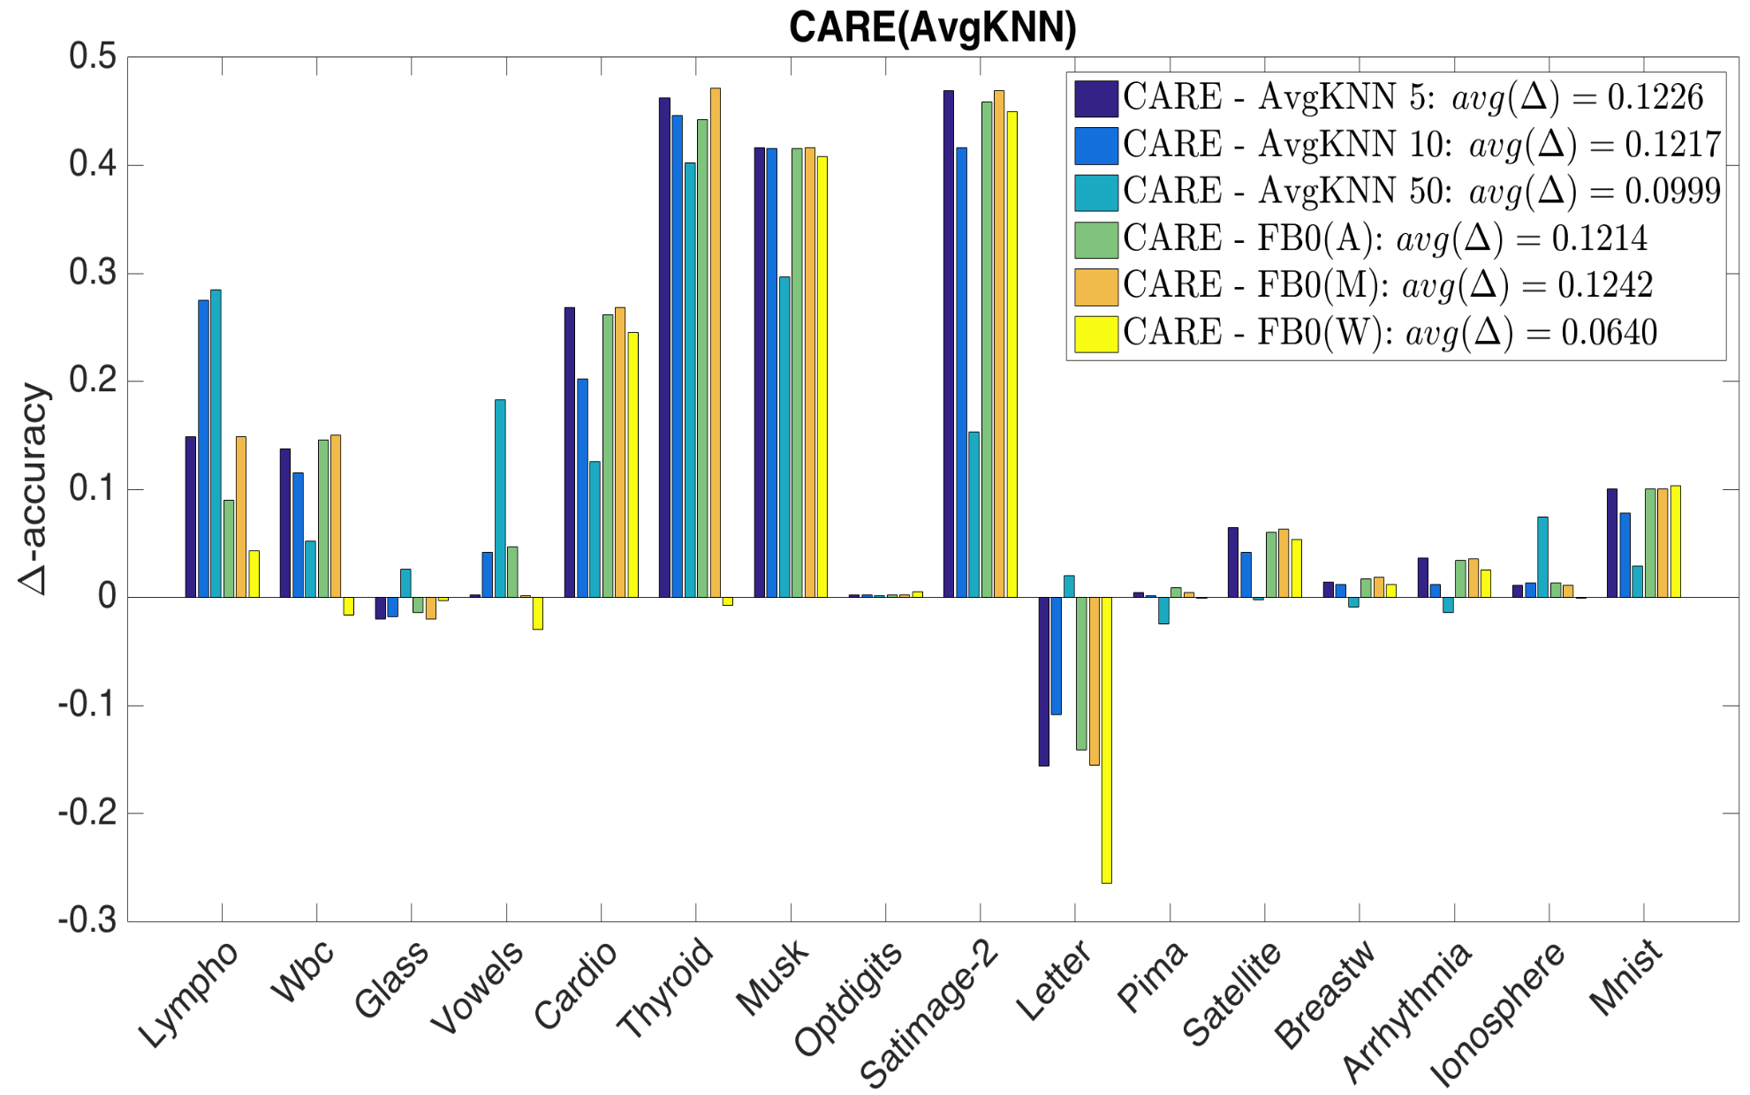
CARE vs. baselines

Slide 19
Existing Outlier Ensembles
Liu et al.’s Isolation Forest (iF) [ICDM 2008]
Zimek et al.’s Subsampling [KDD 2013]
  Sample size – 10% (Z10), 50%(Z50)
Aggarwal & Sathe’s [KDD 2015],
  Variable Sampling (VR)
  Rotated Bagging (RB)
  Variable sampling with Rotated bagging (VR)

Slide 20
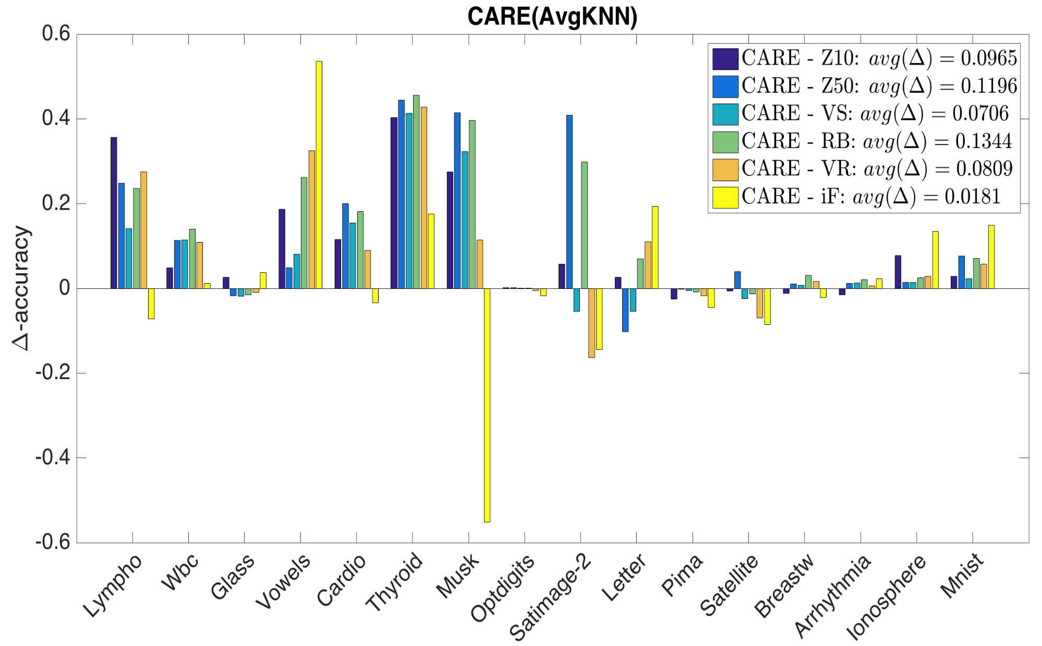
CARE vs. other ensembles

Slide 21
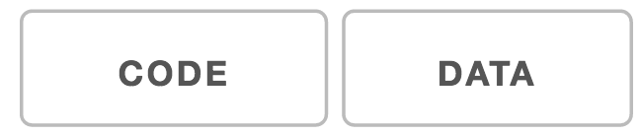
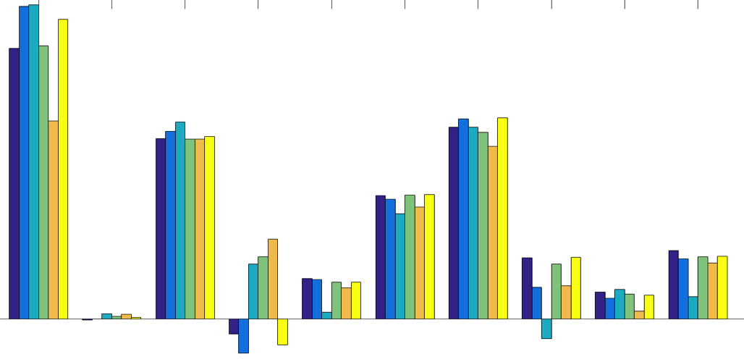



Thanks:
CARE
for
?
CODE
DATA
http://shebuti.com
for Outlier Detection Data Sets
http://odds.cs.stonybrook.edu/

